Slide 1

Dr. A. P. J. ABDUL KALAM TECHNICAL UNIVERSITY, LUCKNOW
A NOVEL APPROACH OF 3D SURFACE MAPPING USING LIDAR TECHNOLOGY AND USE OF OUTPUT DATA IN COMBAT STRATEGIES IN DEFENCE
By Under the Guidance of
Roshani katara Dr. Dushyant Singh M. Tech, Scholar, ECE, Professor
1900040315002 (2019-2021) Deptt. of ECE
R B S Engg. Tech. Campus, Bichpuri R B S Engg. Tech. Campus, Bichpuri
Agra(U.P), India Agra(U.P), India

Slide 2
CONTENTS :-
Abstract
Introduction
About
Background
Purpose of system
Components used
Block diagram
Flow diagram
Working diagram
Hardware setup
Methology of project
Application
Results
Conculsion
Future scope
Reference

Slide 3
ABSTRACT : -
In this projrct we present a 3D surface mapping Technic using lidar . This project is based on lidar . Lidar is employed as remote sensing method which uses light within the type of a pulsed laser to live range with variety of military and Arial used nowdays. This advanced lidar based military system will be won't to minister local patch area and may also scan suspicious robot and drone. Lidar makes uses of light in the form of pulsed laser to measure ranges. It makes a 3D image formed by coordinate scanned through it. We can use this 3D image for further processing and decision making .

Slide 4
INTRODUCTION : -
Lidar ( light detection and ranging ) . It is an optical remote sensing technology that can measure the distance, other propertie target by ilumanting the target with light , often useing pulse from a laser
It's advance version of lidar and sonar . The disadvantages of lidar or sona is there low frequency and precision . In contrast of lidar sonar , the new evolving of technology of lidar has very frequencie and precision , especially for short distance measurement .
Lidar technology has several advantage over the pre- existing technology of radar and sonar as it is much more accurate and reliable . Lidar based dem has a precision of 0.1 m along with sufficient horizontal resolution .
defence there is always need of best information of ground to make combat Strategies .

Slide 5
Various methods are used to fulfill such need. Aerial photography is one of the most common method but this method gives only two dimensions information about area .
But 3D mapping can give greater results with 3D coordinate data . 2D image gives information about any object any object but 3D data can give the information of height of the object . In this project we are designing a system that can make 3D mesh from the collected 3D data .
It's is better to get 3D area image of area lidar is important sensor in 3D detection system It generated prices , high quality , and sometimes even a three - dimensional map of the environment that it scans .
A lidar system consists of a scanner , laser , and sometimes specialists gps receiver as well other elements that are essential for data collection and analysis are optic and photo detector .

Slide 6
ABOUT OF LIDAR TECHNOLOGY : -
Lidar was invented in the early 1960,shortly after the invention the laser
Its first application came in metrology,where the national center for atmospheric research used to measure cloud and aerosol.
The general public became aware of the accuracy and usefulness of lidar system in 1971 during the Apollo 15 mission. When astronaut used a laser altimeter to map surface of the moon.
1995- first commercial airborne lidar system developed.
Lidar was used in the 1970 by NASA who used this laser romte seeing technology in its development of spacecraft .

Slide 7
Lidar scanner were capable of producing 2000 to 25000 pulses per second and were mainly being used for topographic mapping of the earth's surface .
lidar instrument of lidar system 1. Laser 2. Detector
And most of the lidar system works on the the
Principle of the time of light
While the rider system can not works in such environments .

Slide 8
LIDAR USES LASER LIGHT :-
Concept of laser beam was first presented by Einstein in 1971.
Laser is a device for producing a very narrow beam of highly intensive monichromatic cohesent light.
Why to use lidar :- because the speed and accuracy laser is too much.
600 - 1000 nm lases is used for non scientists application
1500 mm laser is used for military application.

Slide 9
COMPONENTS OF LIDAR SYSTEM : -
Photodetector and electronic receiver
scanner and optices.
GPS
Aircraft
Ultrasonic module

Slide 10
PURPOSE OF SYSTEMS :-
Developing a lidar 3D surface navigation and modelling system
Testing of various algorithms to processing the 3D data
Processing data and convert it into 3D coordinate point data that can be projected the 3D image of the field
Applying resolution implementation and cohesion techniques .
With this system , minor object can be detected from battle field such as weapon no of enemy and exact possible of terrain of the battlefield
And find out exact position of enemy and their capacity.
The purpose of this system is to do scanning by going to low height

Slide 11
COMPONENTS USED :-
Arduino mega 2560
Microchip atmega 2560
Lidar module
Lm 2596
wemos
ultrasonic module

Slide 12
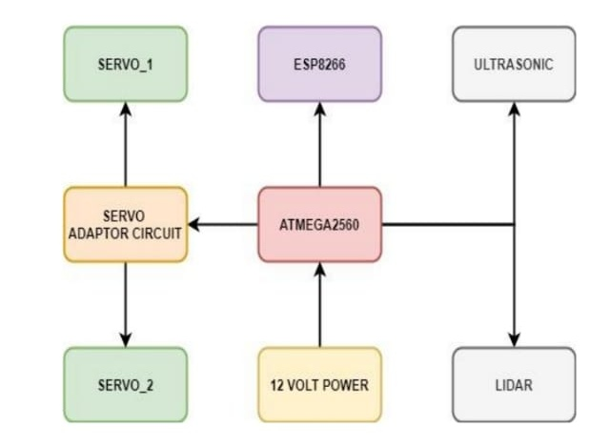

Slide 13
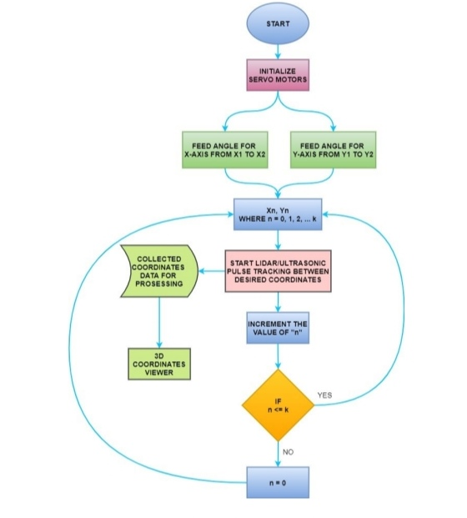
FLOW DIAGRAM OF LIDAR :-

Slide 14
WORKING OF PROJECT :-
It scan object Object on the surface Using laser light
Help to make 3 d model of his shape A device emitt laser signal on a surface
when the reaches the object and reflect
then the reciever received those signal on a surface
When the ig reaches the object the reflect
Then the receiver recieves those signal
Then we make 3d coordinate representation according to the calculation of the return time and wave speed And then represent all coordinate in combine form
Servo motor move the laser sig to different direction untill the signal reaches an object .

Slide 15
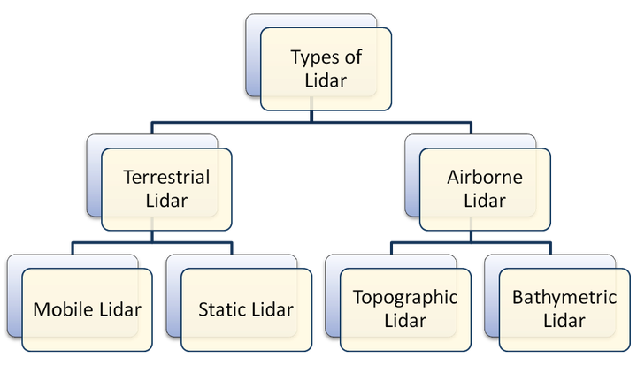
TYPES OF LIDAR :-

Slide 16
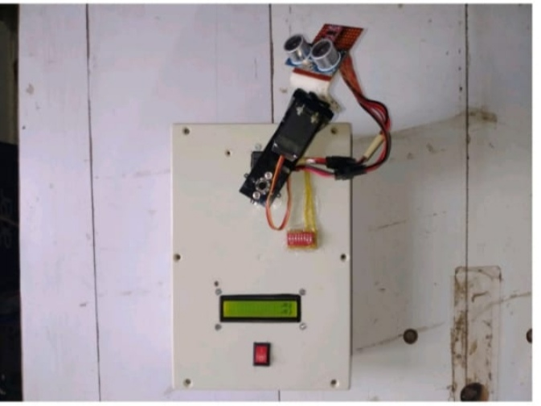
HARDWARE SETUP :-

Slide 17
METHODOLOGY :-
Light detection and ranging is a technology similar to radar using laser instead of radio waves . Lidar principal is pretty easy to understand
It emits a laser pulse on a surface
Catches the reflected laser back to the lidar pulse source with
Measure the time laser travelled
Calculate the distance from sources with the formula “ distance = ( speed of light x time elapsed ) / 2
This process is repeated a million times by lidar instrument and ends up producing a complex map of the surveyed area known as a 3d point cloud .

Slide 18
APPLICARTIONS :-
Military
Self driving car
Agriculture
Atmosphere remote sensing and meterold
Astronomy
Land management
Climate change
Robitics

Slide 19
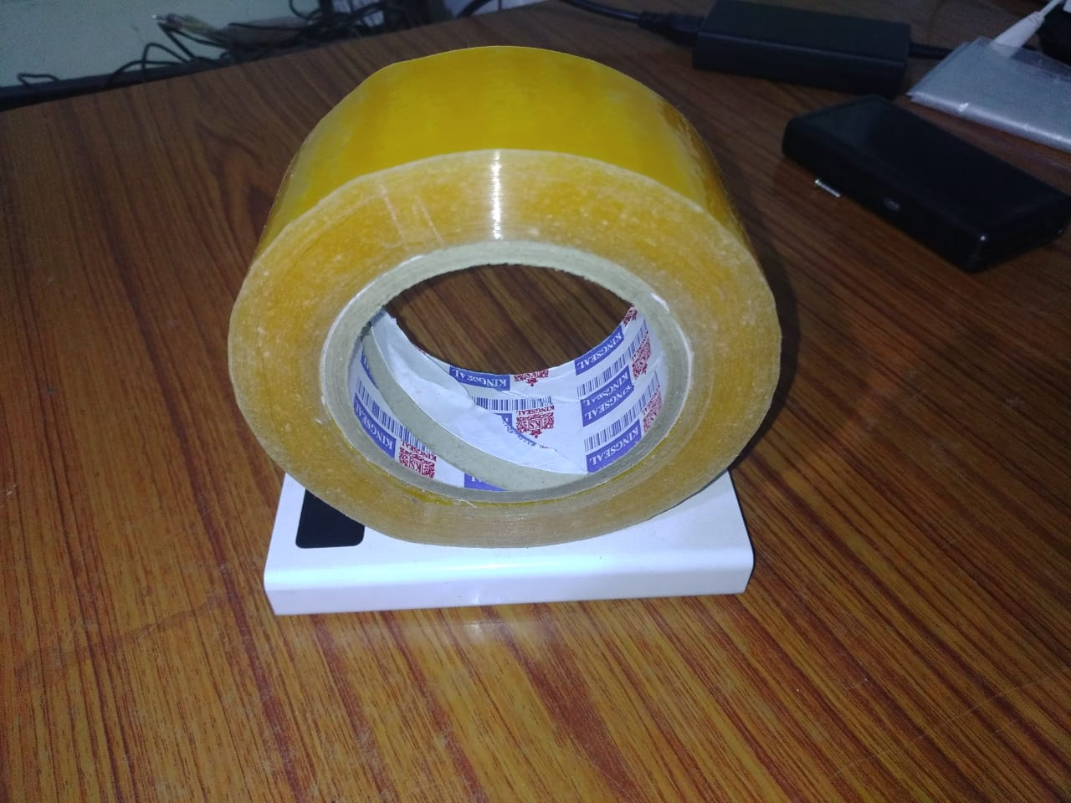
Result :-

Slide 20
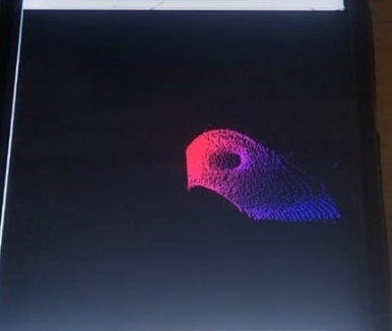
Scanning result of an object : -

Slide 21
CONCLUSION :-
Lidar has the superior performance than tha pre- existing radar and sonar technology due to its high accuracy and resolution . 3D mapping is required particularly to build the map of any given surrounding . 3D mapping using lidar is very accurate, reliable and cost effective . Lidar is mounted on a fingered v servo motor which maps the given environment in 3D.

Slide 22
FUTURE SCOPE :-
This device can be made compact
range can be varied about 20 cm to 200 m
it can be prepared for fast processing fast processing
cm be done if multiple micro controller is used wife it
Weight can be reduced

Slide 23
REFERENCE :-
Simple and cost-effective 3 - dimensional(3D) mapping of internal structures Light Detection and Ranging (LiDAR), Authors: VandanaV , Yashaswini S , Vidya B, PaperID: IJERTCONV6IS13090 , Volume & Issue : NCESC –2018 (Volume6 Issue13) ,Published (FirstOnline) : 24-04-2018 ,ISSN (Online) : 2278-0181 , Publisher Name :IJERT . https://www.ijert.org/3d-mapping-using-lidar
Airborne LiDAR Technology :A Review of Data Collection and Processing Systems by Bharat Lohani Sudhasheelgosh ,Proceeding of thenational academy of sciences ,indiasectionA :Physical Sciences 87,567-579(2017). https://link.springer.com/article /10.1007%2Fs40010-017-0435-9
Integration of light detection and ranging technology with photogrammetryin highway location and design by David Veneziano ,Riginald, solueyrette ,Shauna Hallmark, Volume 1836, first published January 1, 2003. https://journals.sagepub.com /doi/ 10.3141/1836-01 4.W.Shen ,J.Zhangand F.Yuan,"Anewalgorithm of buildingboundary extraction basedon LIDAR data ,"201119th International Conferenceon Geoinformatics, Shanghai, 2011, pp.1-4.doi:10.1109 /GeoInformatics.2011.5981049.

Slide 24
REFRENCE CONT….:-
Monocular Camera Localization in Prior LiDAR Maps with 2D-3D Line Correspondences by HuaiYu and WeikunZhen and Wen YangandJi Zhangand Sebastian Scherer, Proceedings of(IROS)IEEE/RSJ International Conferenceon

